Slide 1

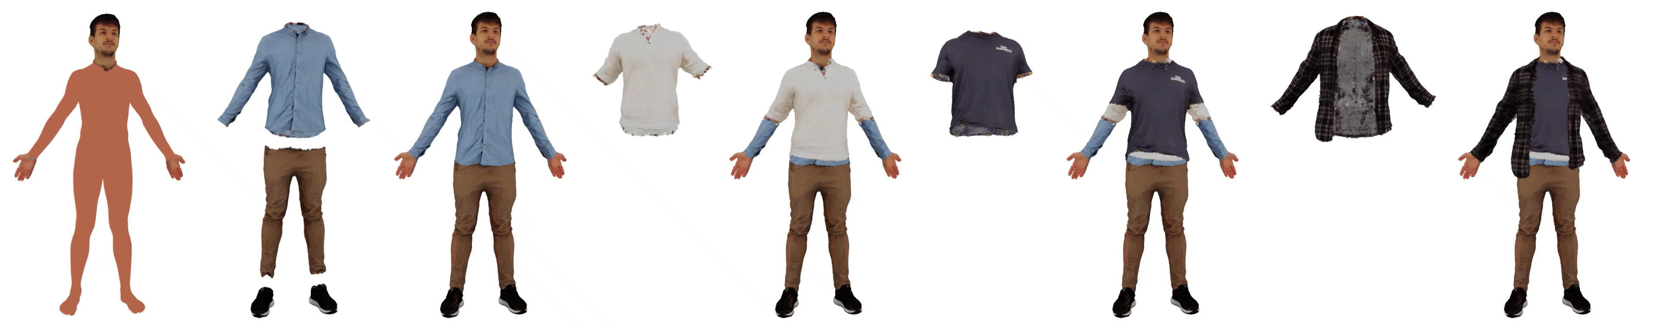






DAMA: Disentangled Body-Anchored Gaussians for Controllable Multi-Layered Avatars
Daniel Eskandar · Berna Kabadayi · Garvita Tiwari · Gerard Pons-Moll
PhysHuman Workshop @ CVPR 2026
Notes:
We present DAMA: Disentangled Body-Anchored Gaussians for Controllable Multi-Layered Avatars.
DAMA reconstructs physically plausible layered avatars with explicit control over garments.

Slide 2
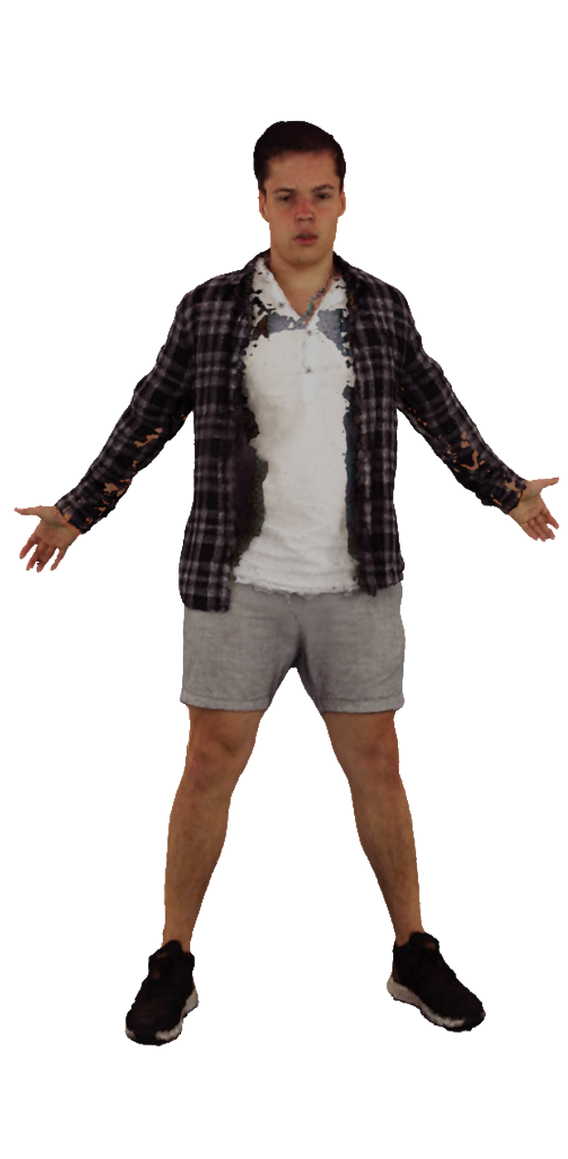
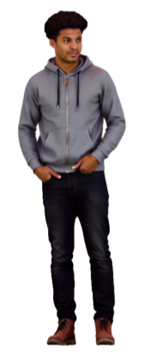
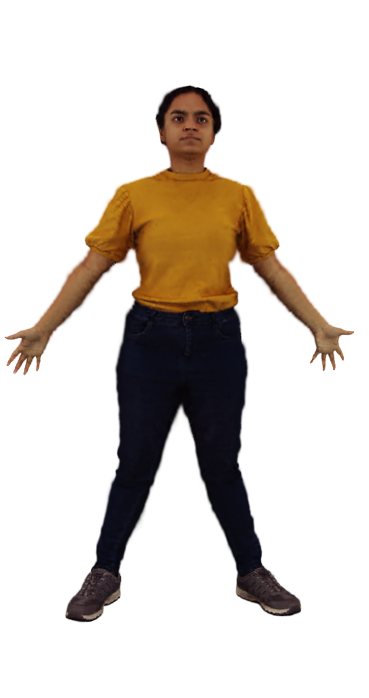
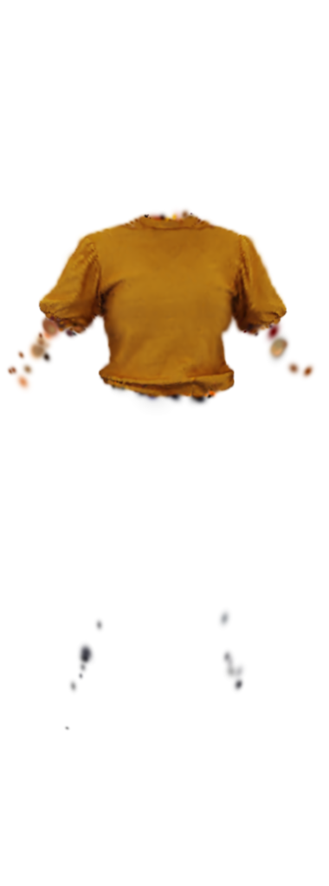
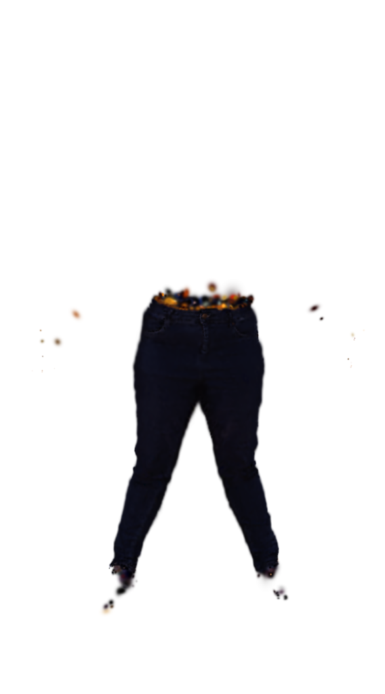
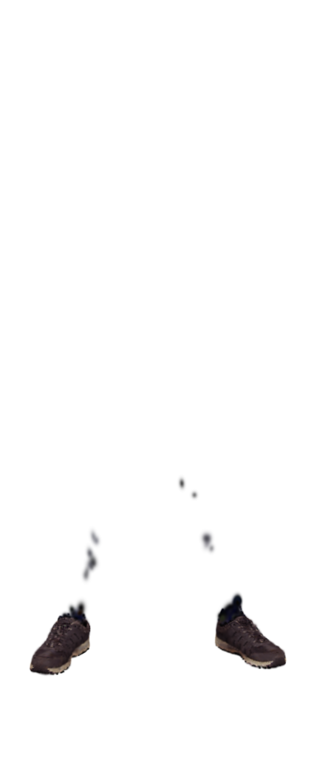
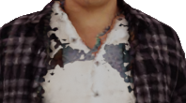
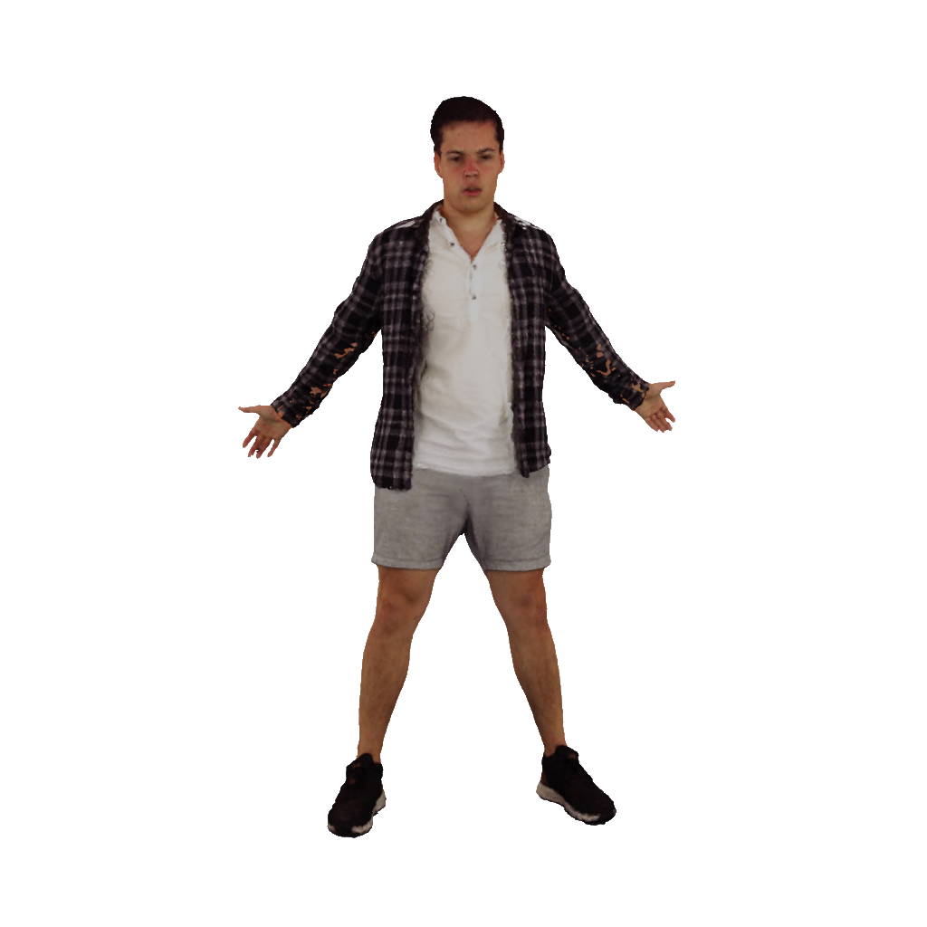
Current Avatars Overlook Physical Layering
Current methods achieve high visual fidelity but overlook physical layering.
Single Surface
Noisy Boundaries
Layer Intersections
InfiniHuman (SIGGRAPH Asia’25)
Disco4D (CVPR’25)
GALA (CVPR’24)
Physical layer ordering is not explicitly represented or enforced.
Notes:
Current avatar methods achieve impressive visual quality, but they largely overlook physical plausibility.
Most represent clothing as a single surface with no garment-level control.
Methods that separate garments often produce noisy boundaries, floating artifacts, or layer intersections when garments are combined.
The key limitation is that layer ordering is neither explicitly represented nor enforced.

Slide 3
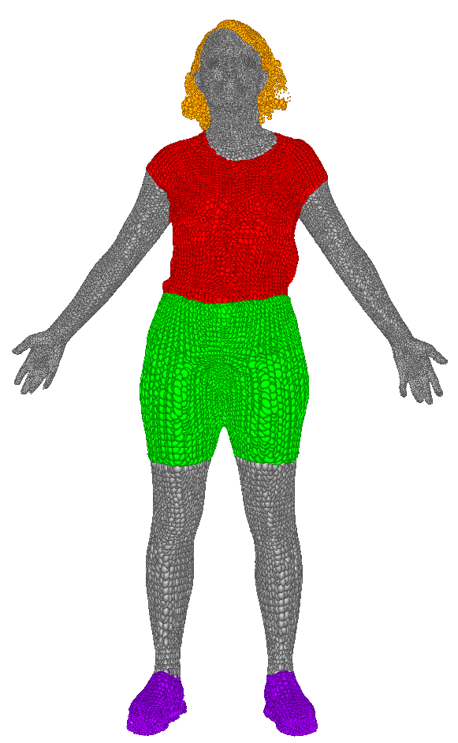
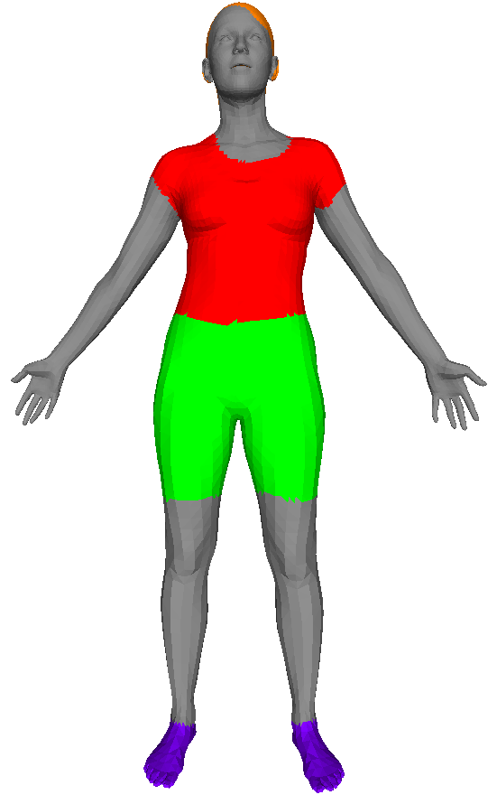
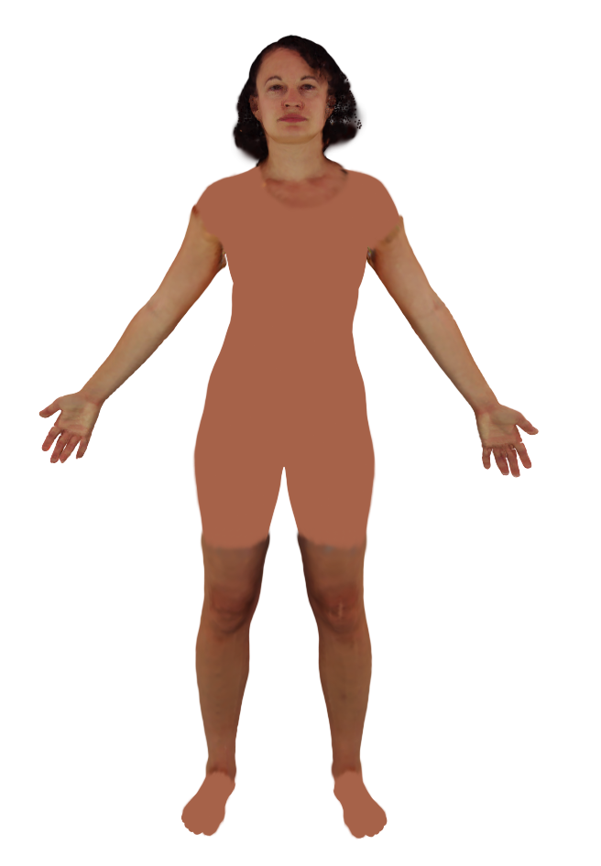
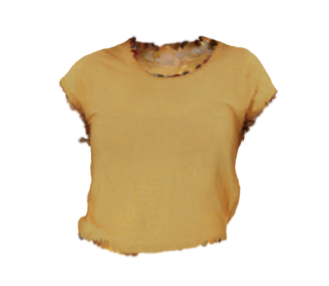
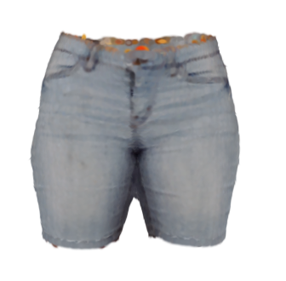
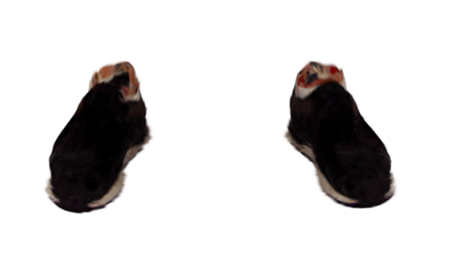
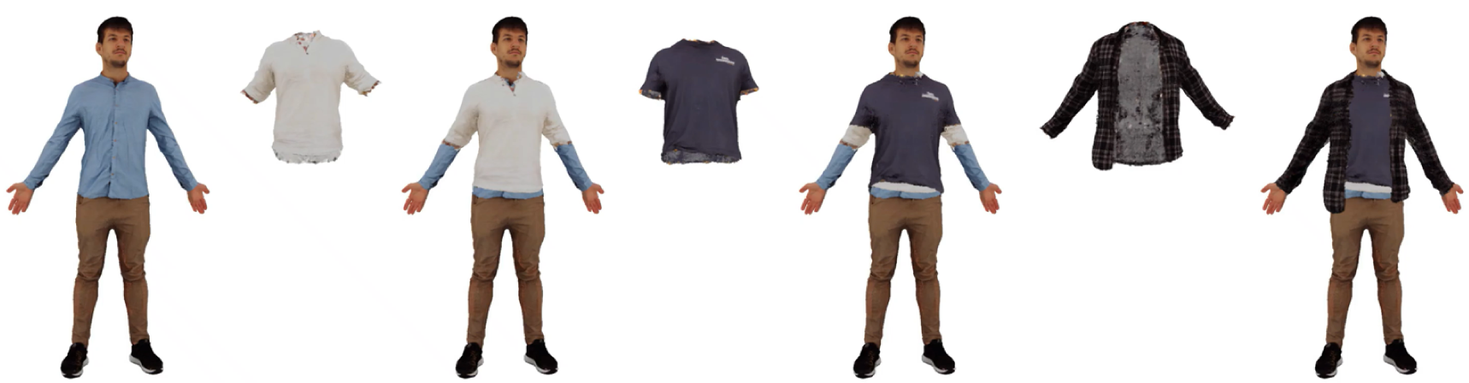
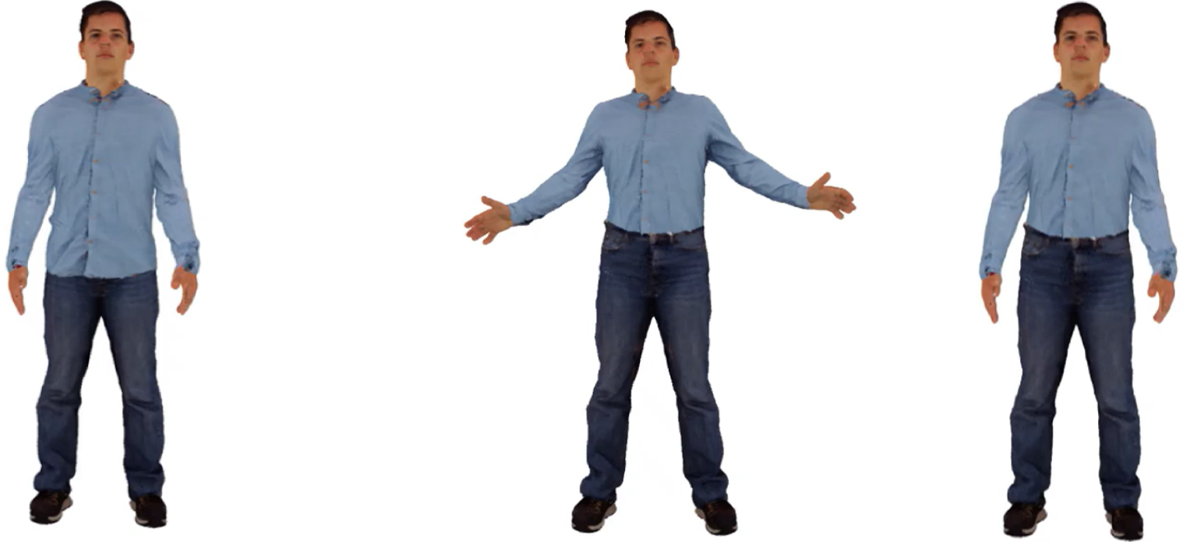
DAMA Encodes Layering by Design
Dama introduces three key contributions:
1. Layer-aware Gaussian representation
2. Topology-aware layered reconstruction
Garment Stacking
Garment Reordering
Simulation-Ready Meshes
3. Layer-aware garment manipulation
Notes:
DAMA addresses this problem through three contributions.
First, we introduce a layer-aware Gaussian representation.
Second, we propose a layered reconstruction method that produces clean and disentangled garment layers.
Finally, we demonstrate applications enabled by this representation, including garment stacking, garment reordering, and extraction of simulation-ready garment meshes.

Slide 4
Layer-Aware Representation
Lateral Drift
Outside Body
Surface
Inside Body
Body
Penetration
Barycentric surface position
Positive normal offset
Local parameterization
Layer-aware parameterization
GausianAvatars (CVPR’24)
DAMA (Ours)
Barycentric coordinates prevent drift and positive offset prevents body penetration.
Notes:
We start with our layer-aware representation.
Imagine this line as the body surface, with the outside above and the inside below.
Previous methods represent each Gaussian relative to the center of a mesh face.
As a result, Gaussians can drift away from the surface or even move inside the body.
Instead, we represent positions inside the mesh face using barycentric coordinates.
We then apply a strictly positive offset along the surface normal.
This keeps every Gaussian attached to the local mesh surface and guarantees it remains outside the body.
In short, barycentric coordinates prevent drift, while positive offsets prevent body penetration.

Slide 5
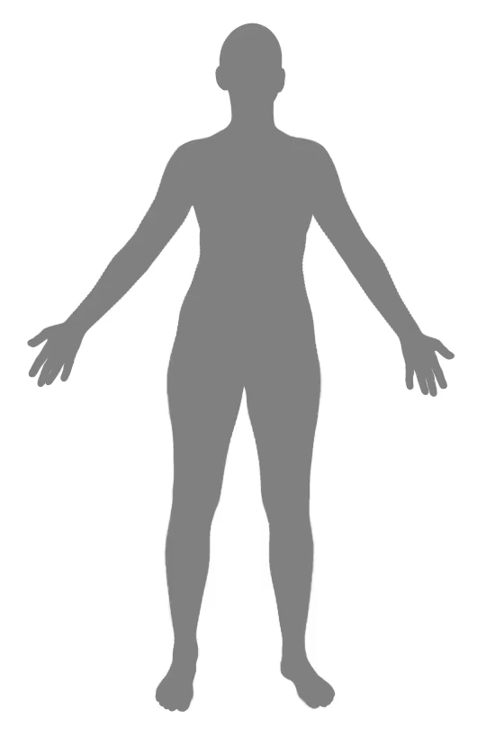
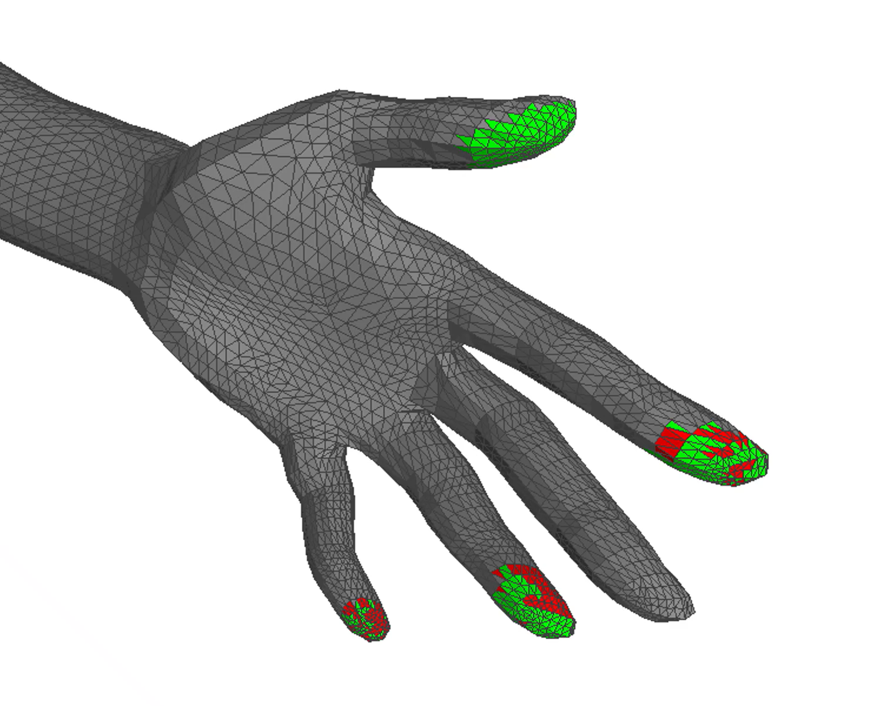
Layered Reconstruction
Notes:
Next, we introduce our layered reconstruction pipeline.
The inputs are multi-view images, segmentation masks, and a registered SMPL-X body.
We first reconstruct coarse geometry and lift the segmentation labels into a set of segmentation Gaussians using our body-anchored representation.
Notice how the Gaussians naturally grow outward from the body during reconstruction.
However, lifting labels can introduce small noisy segmentation regions.
Our representation allows us to project labels onto the SMPL-X mesh, detect these regions using mesh connectivity, and refine them using neighboring labels.
After refinement, each garment layer is reconstructed independently to recover fine geometry and appearance.
Finally, all layers are merged to produce the complete clothed avatar.

Slide 6
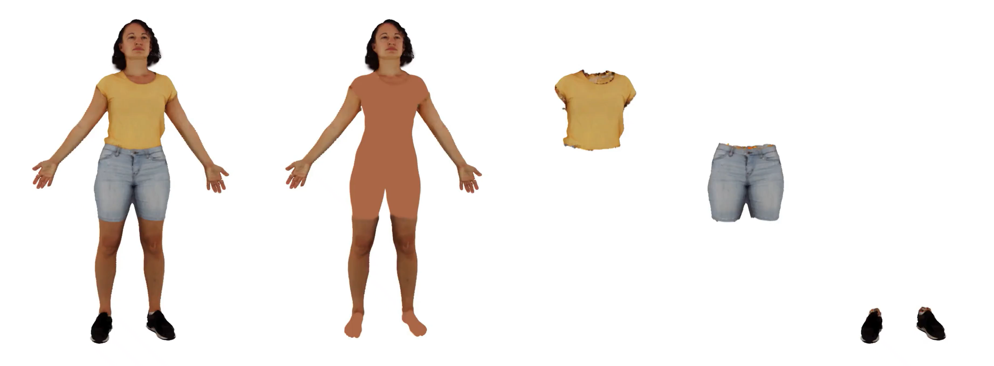
DAMA Reconstruction Results
Notes:
Here we show 360-degree renderings of our reconstructed avatars.

Slide 7
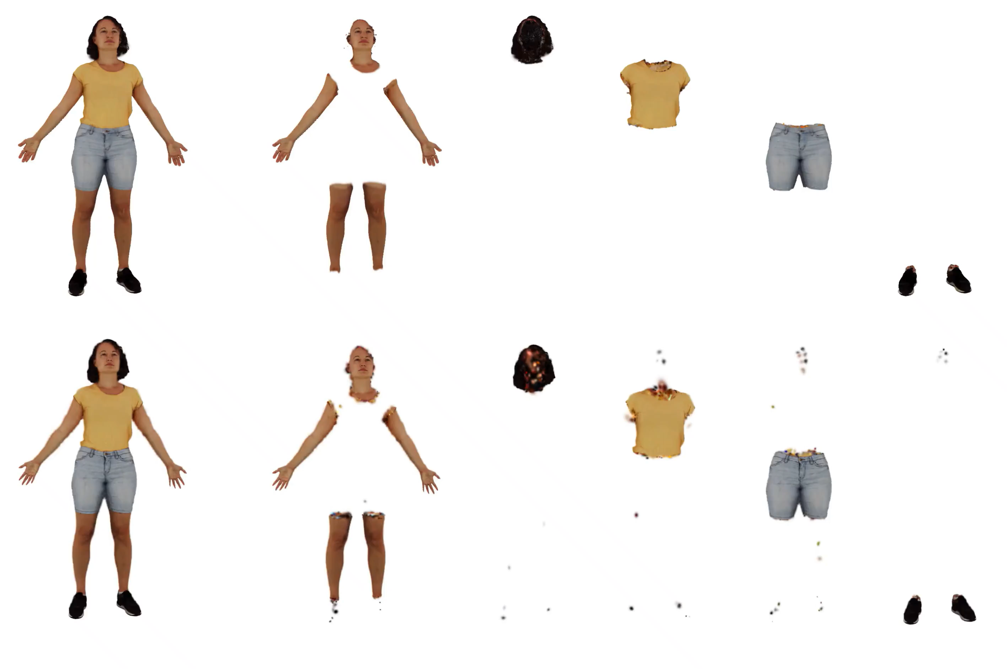
Comparison with Disco4D
DAMA
(Ours)
Disco4D
(CVPR’25)
Notes:
We compare against Disco4D.
Notice that our reconstruction produces cleaner garment boundaries and avoids floating artifacts.
This improvement comes from our label refinement stage.

Slide 8
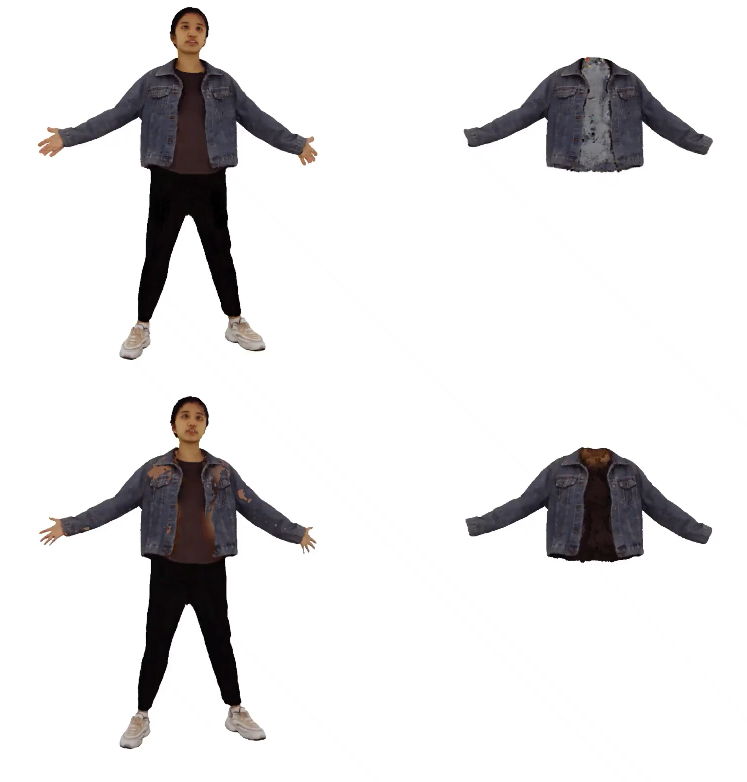
Comparison with GALA
DAMA
(Ours)
GALA
(CVPR’24)
Notes:
We also compare against GALA.
Notice that our layered reconstruction avoids intersections and prevents inner layers from leaking through outer garments.
This improvement comes from our Gaussian parameterization.

Slide 9
Applications
Notes:
Next, we showcase applications enabled by our representation.

Slide 10
Layer Ordering
Layer 1
Layer 2
Merged Layers
Notes:
Consider two reconstructed garment layers, either from the same avatar or from different avatars.
Naively combining them can create intersections.
Because each layer is represented as a positive offset from the body, we can directly adjust these offsets and push the outer layer beyond the inner one.
This gives explicit control over garment ordering while preventing intersections.

Slide 11
Layer Ordering
Layer 1
Layer 2
Layer 2 > Layer 1
Notes:
Consider two reconstructed garment layers, either from the same avatar or from different avatars.
Naively combining them can create intersections.
Because each layer is represented as a positive offset from the body, we can directly adjust these offsets and push the outer layer beyond the inner one.
This gives explicit control over garment ordering while preventing intersections.

Slide 12
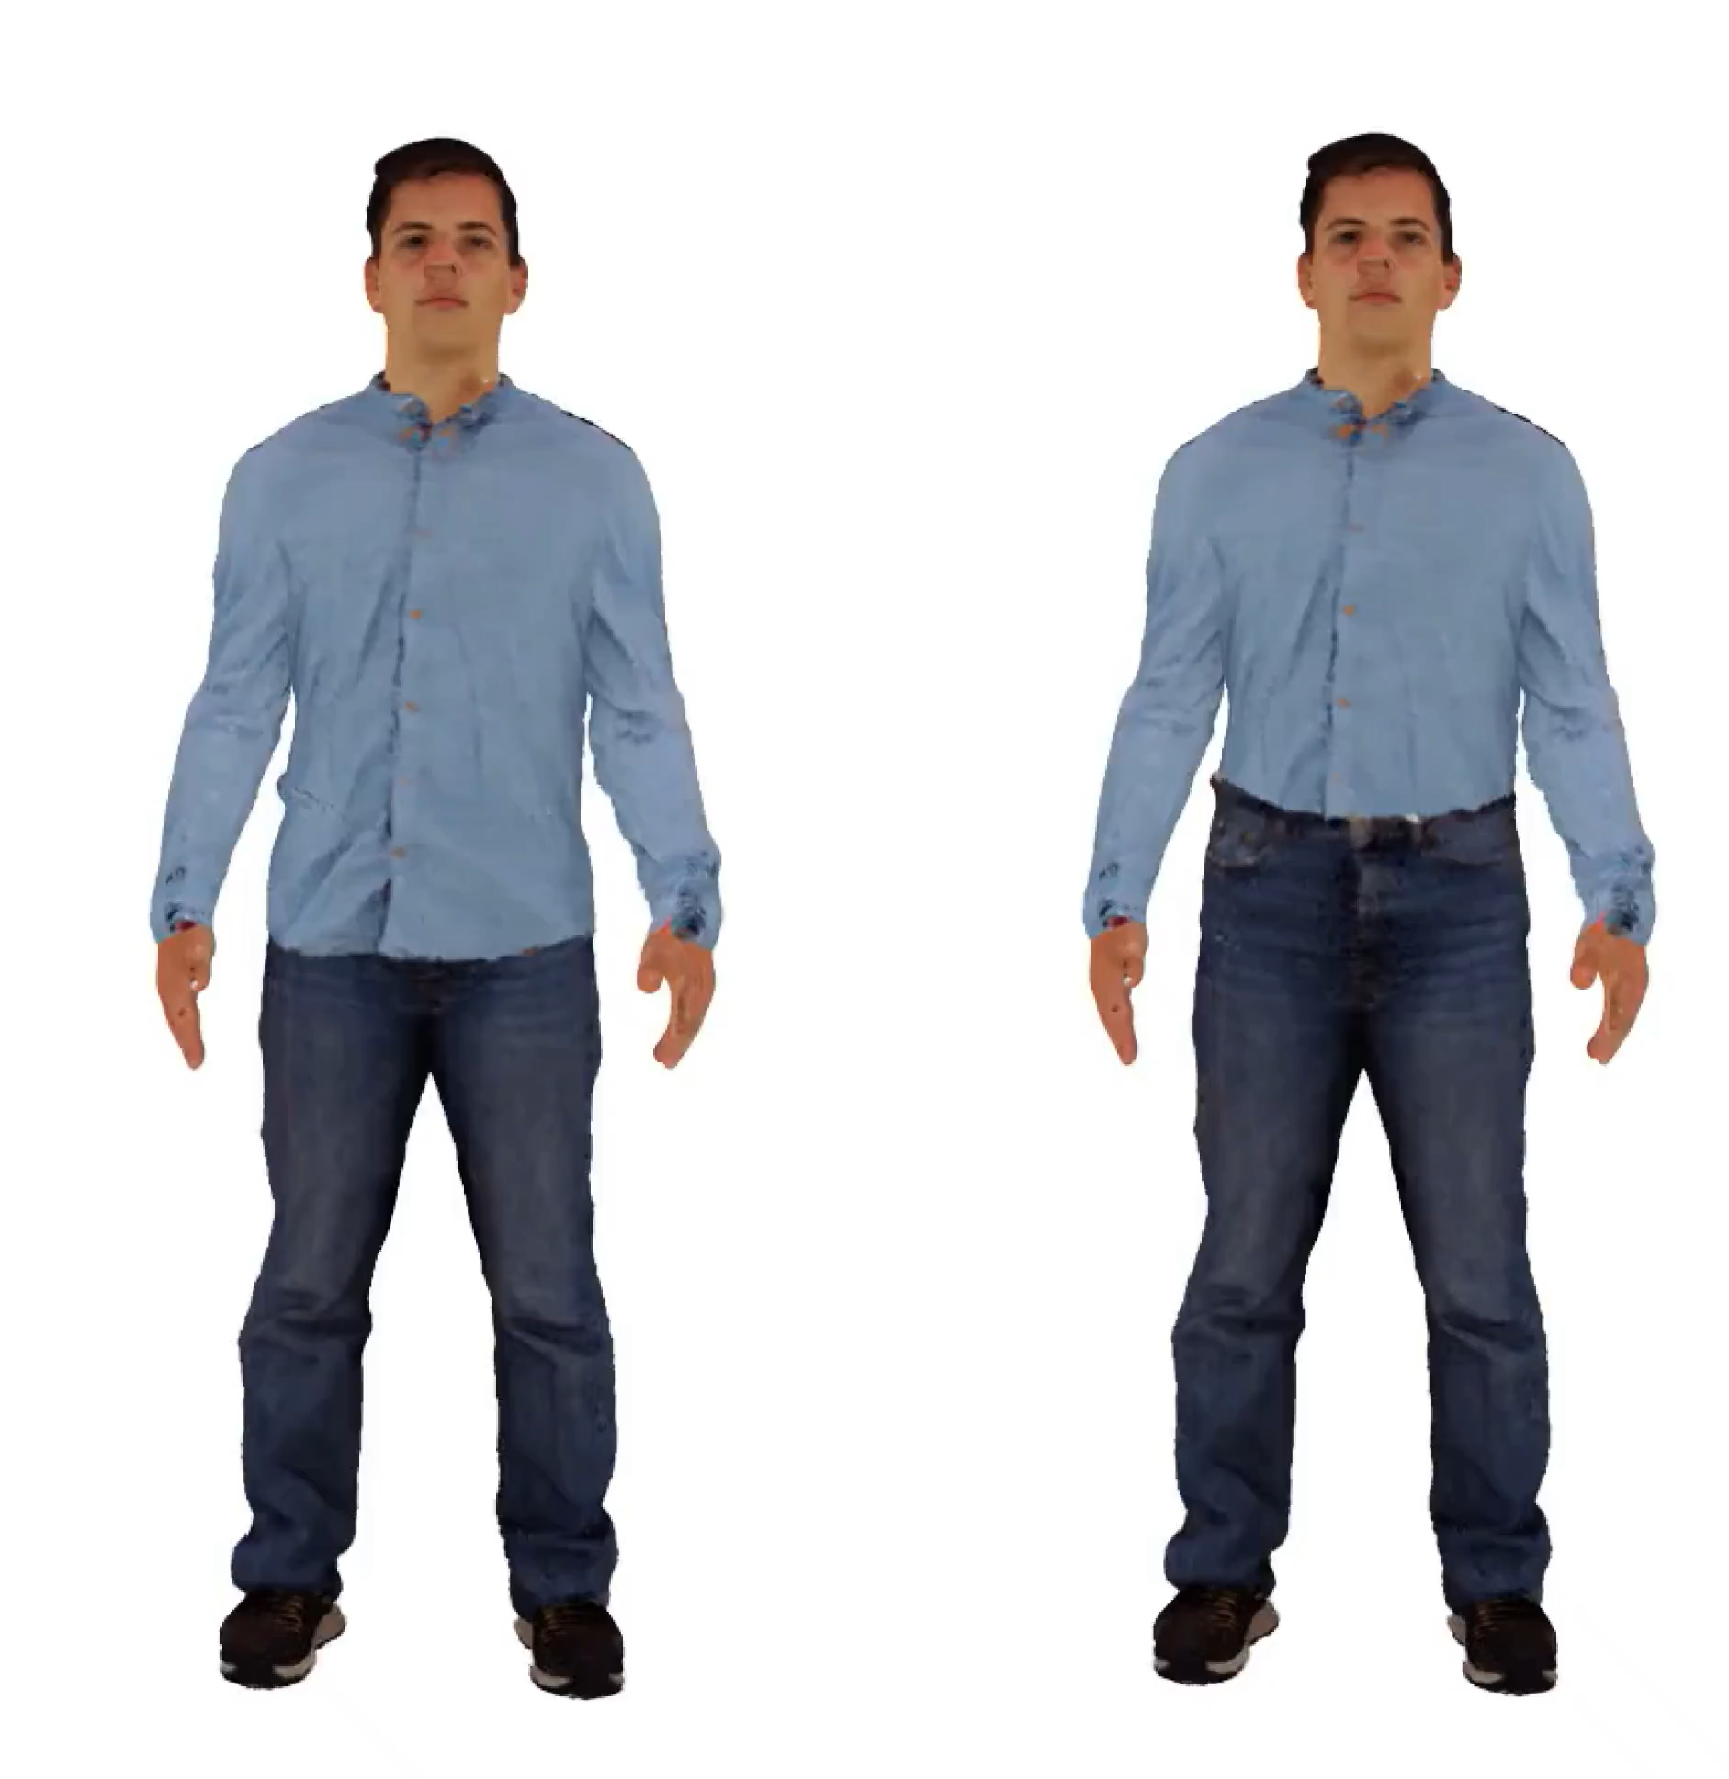
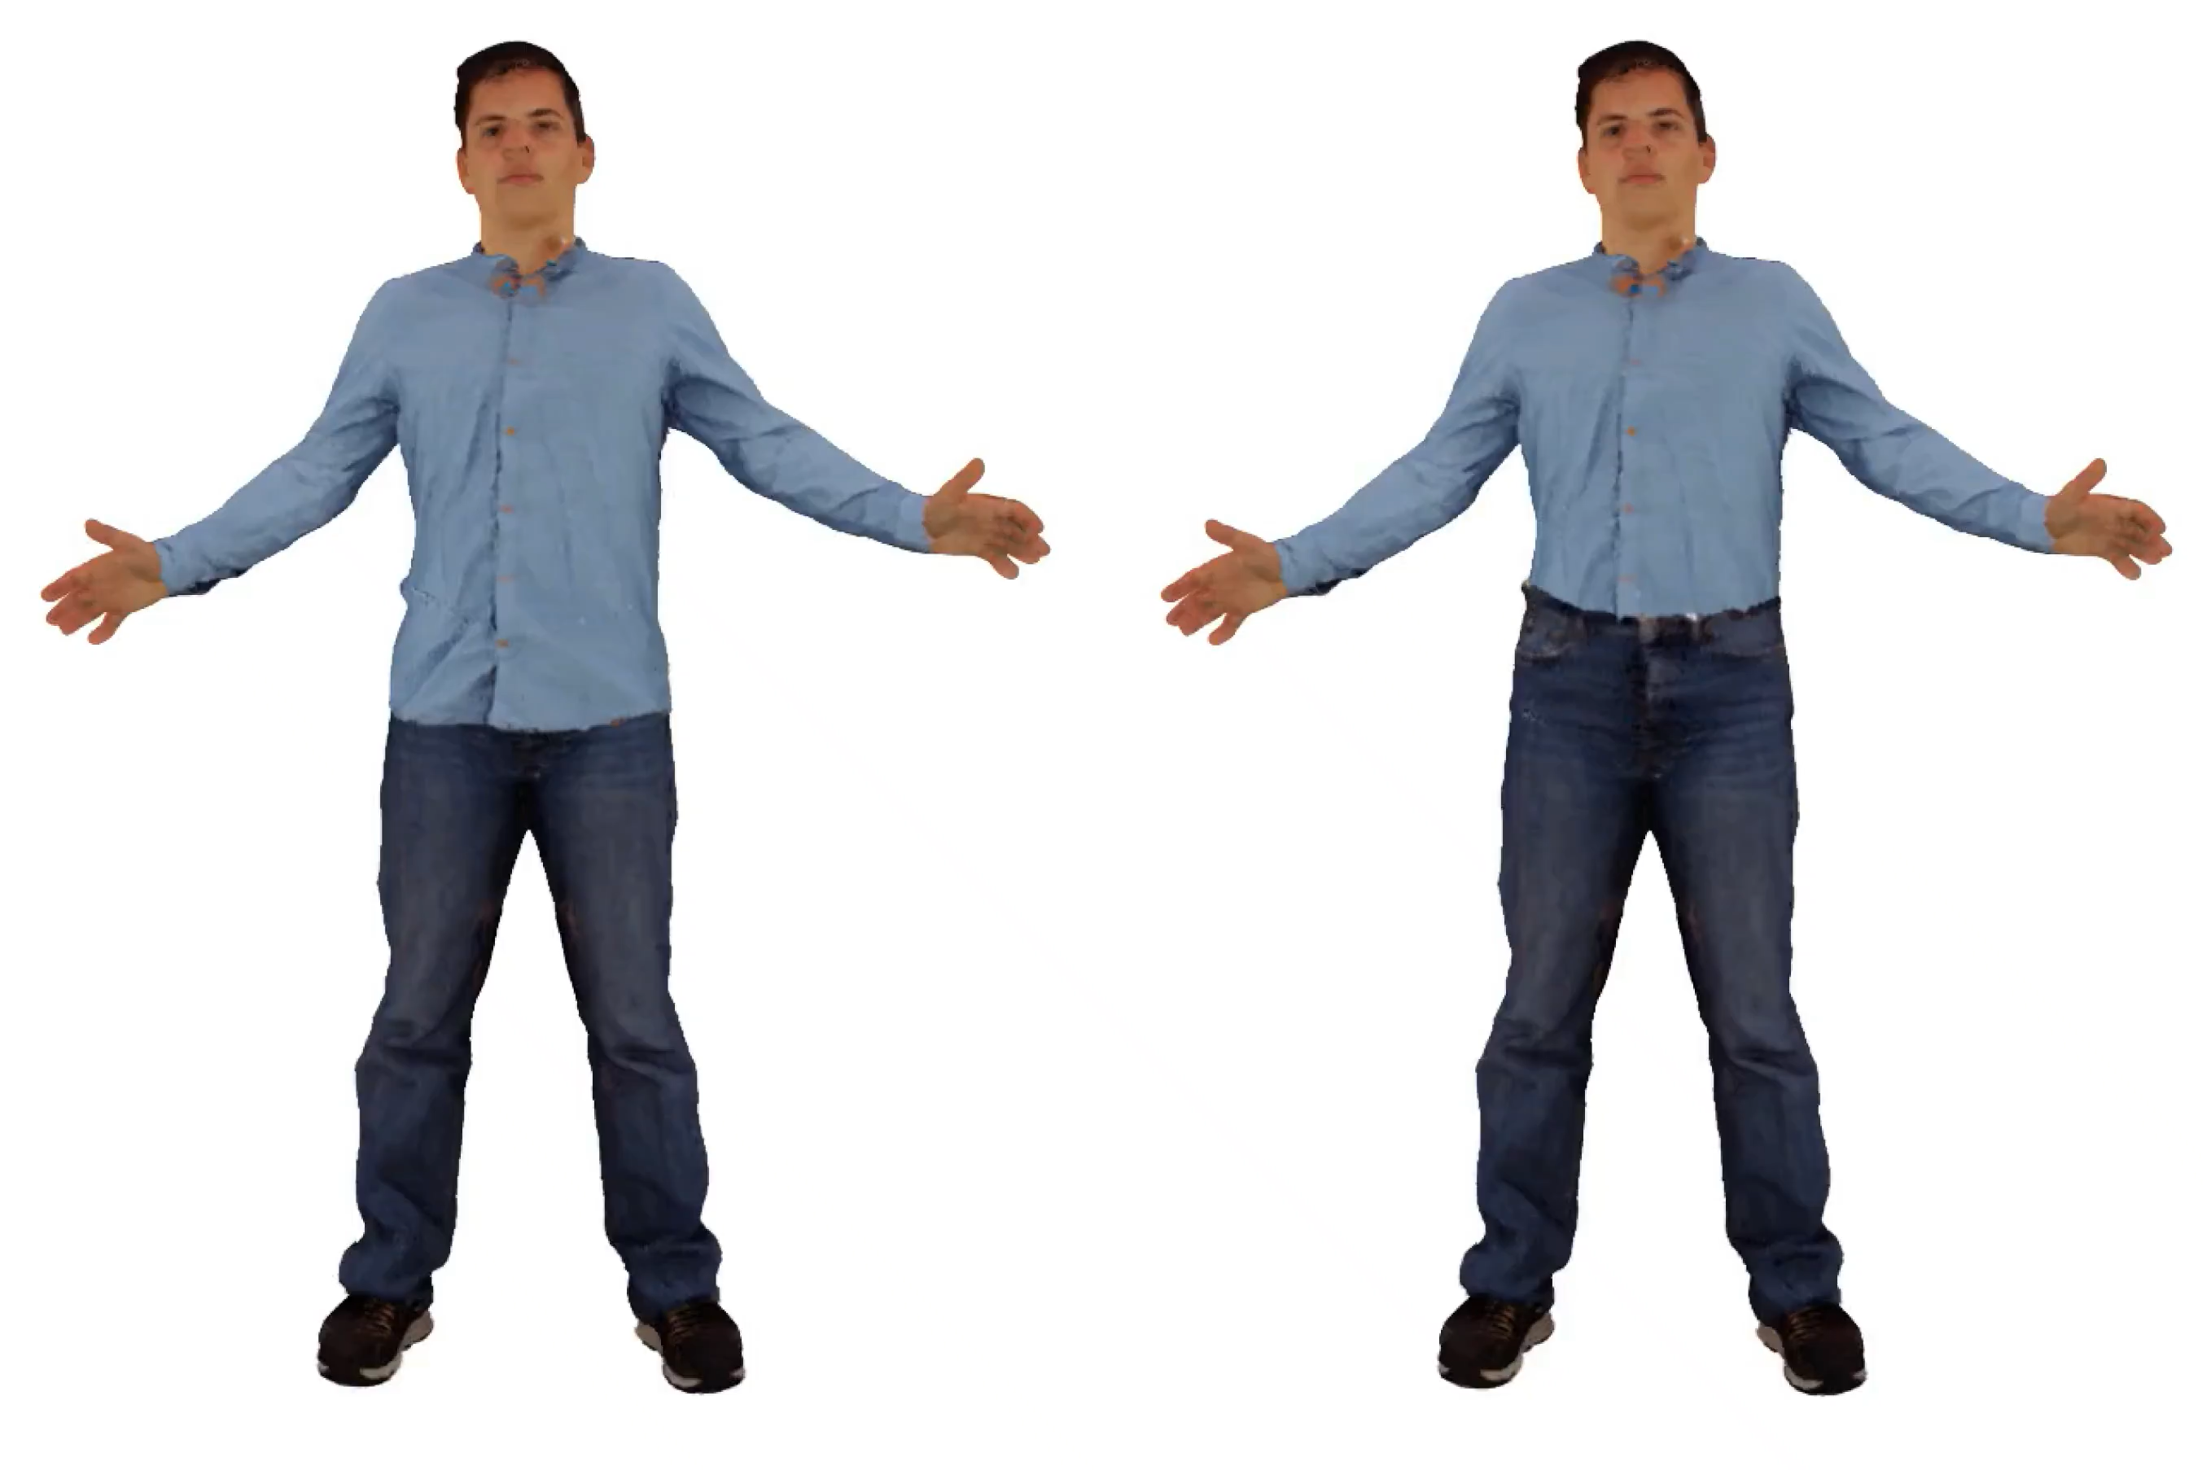
Garment Reordering
Shirt > Jeans
Jeans > Shirt
Shirt > Jeans
Jeans > Shirt
Reconstruction
Animation
Notes:
This allows us to reorder garments.
For example, a shirt can be worn tucked into jeans or over them.
Notice that the chosen layer ordering remains consistent across viewpoints and throughout the animation.

Slide 13
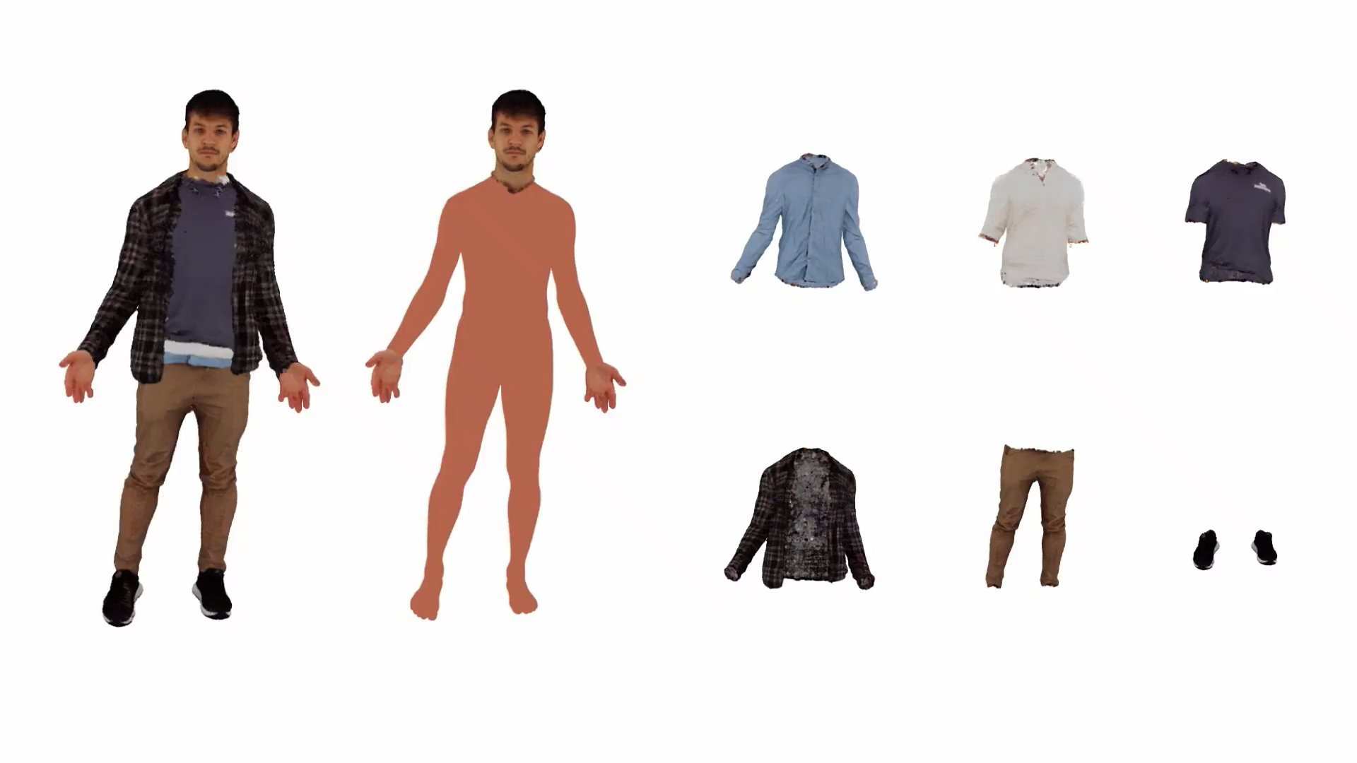
Garment Stacking
Notes:
The same mechanism allows us to stack multiple garments.
In this example, several upper-body layers are combined while preserving their ordering during animation.

Slide 14
Mesh Extraction from Layers
Compute mean Gaussian position for each vertex.
Reuse SMPL-X mesh connectivity.
Layer 2 Mesh
Layer 1 Mesh
SMPL-X Mesh
Notes:
Our representation also enables instant mesh extraction.
First, we compute vertex positions from the Gaussian representation for each layer.
We then reuse the SMPL-X mesh connectivity to construct garment meshes directly.
These ordered meshes can be directly used in physics simulators.

Slide 15
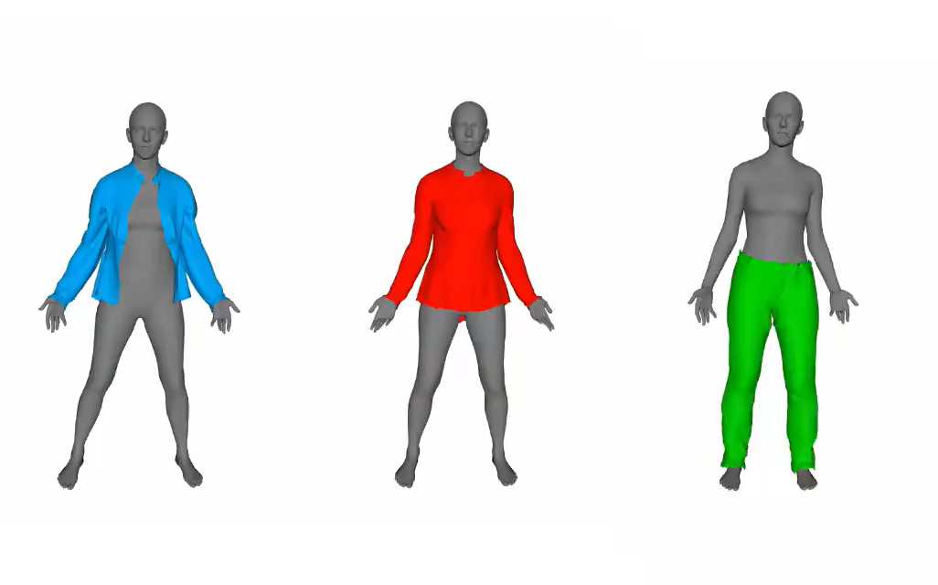
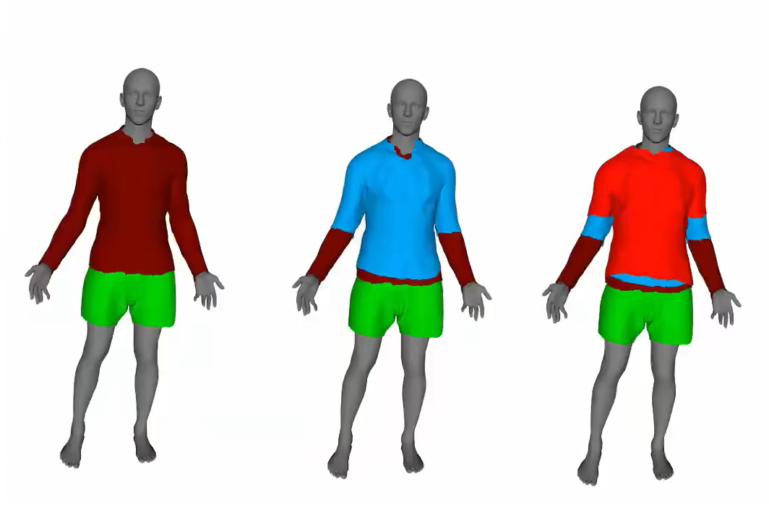
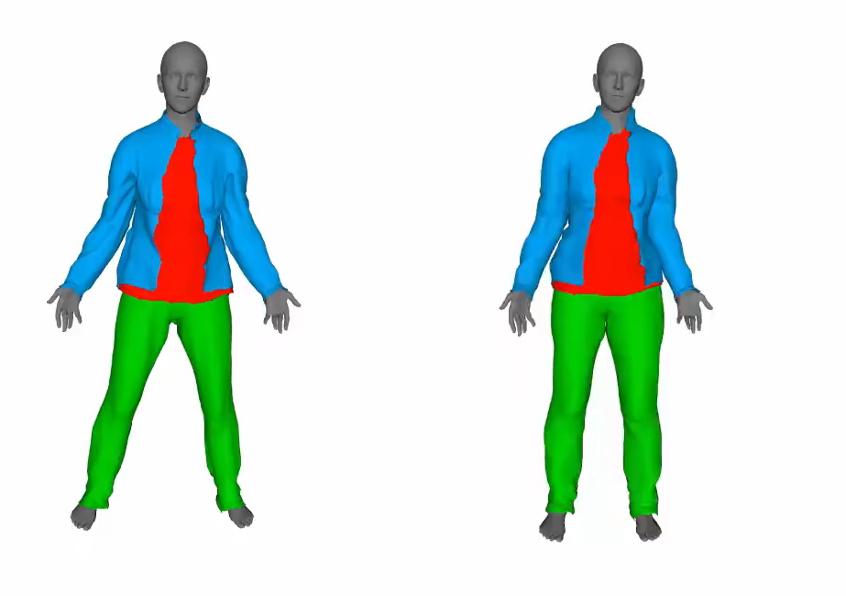
Physics-Based Simulation
Individual Garments
Full Outfits
Stacked Garments
Notes:
We demonstrate simulation of individual garments, complete outfits, and stacked clothing combinations.

Slide 16
Conclusion
Notes:
To summarize, DAMA reconstructs clean and disentangled garment layers from multi-view images.
These layers can be transferred, reordered, stacked, animated with SMPL-X, and converted into simulation-ready assets.

Slide 17
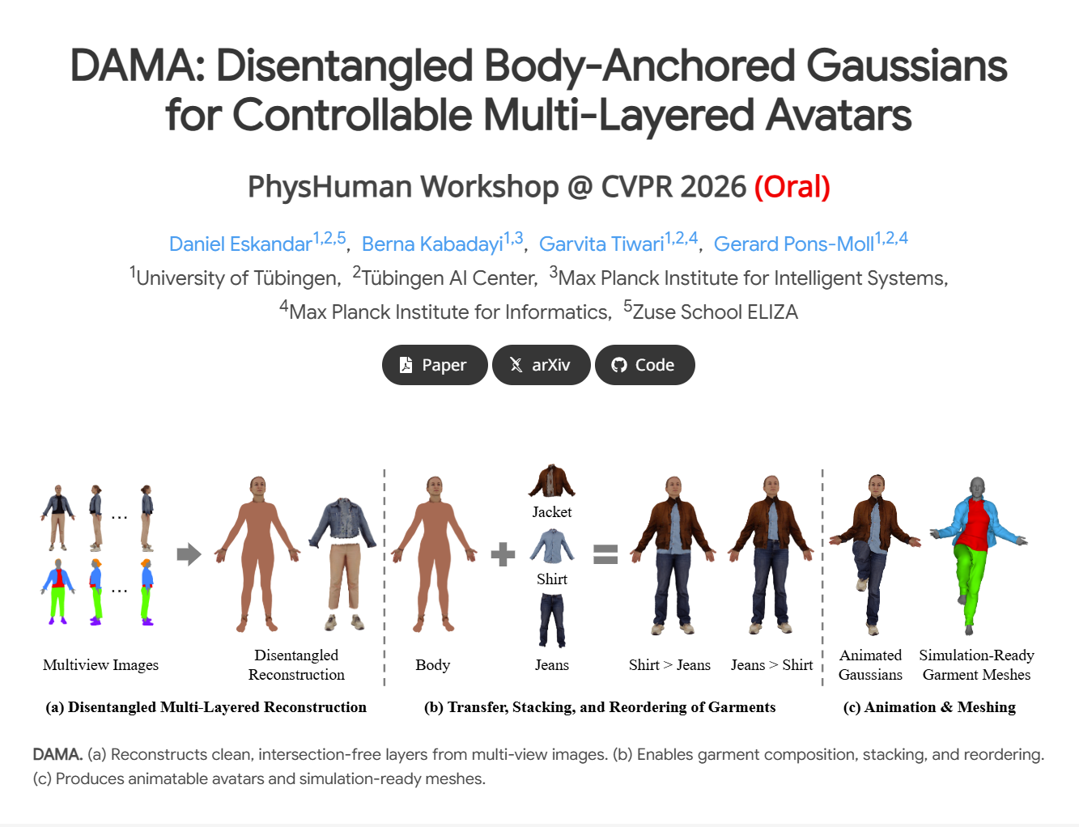
Notes:
For more details and additional results, please visit the project website.
Thank you.

